Slide 1
Blue Cross Blue Shield of Kansas Medicare Advantage Sales Team Training
August 07, 2024

Slide 2
Introductions

Slide 3
2025 MA Benefit Changes
The Medicare Advantage Product Team researched and analyzed the Medicare Advantage product offerings in our service area for 2025.
The team determined there was a need for some benefit changes in 2025 to stay competitive and continual growth of our Medicare Advantage membership.
14 NEW counties have been added to our BMA Choice, Freedom, and BMA Comprehensive plans. The new counties are Allen, Anderson, Bourbon, Chautauqua, Cherokee, Crawford, Elk, Greenwood, Harper, Labette, Montgomery, Neosho, Wilson, and Woodson counties.

Slide 4
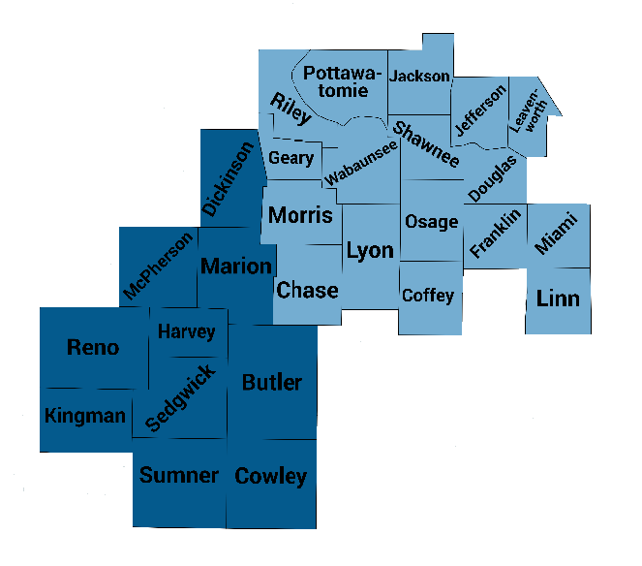
2025 Blue Medicare Advantage (PPO)
There are two distinct service areas for our BMA (PPO) plan.
Wichita Region consists of 10 counties (Butler, Cowley, Dickinson, Harvey, Kingman, Marion, McPherson, Reno, Sedgwick, and Sumner.
Topeka Region consists of 17 counties Chase, Coffey, Douglas, Franklin, Geary, Jackson, Jefferson, Leavenworth, Linn, Lyon, Miami, Morris, Osage, Pottawatomie, Riley, Shawnee, and Wabaunsee.

Slide 5
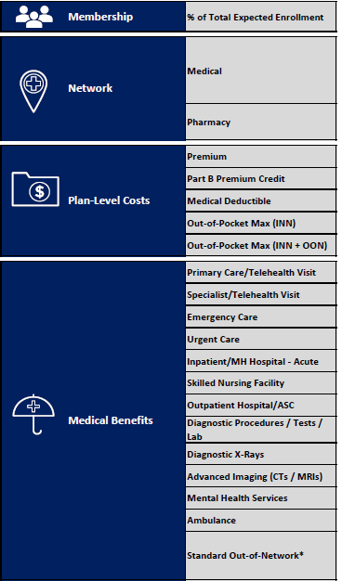
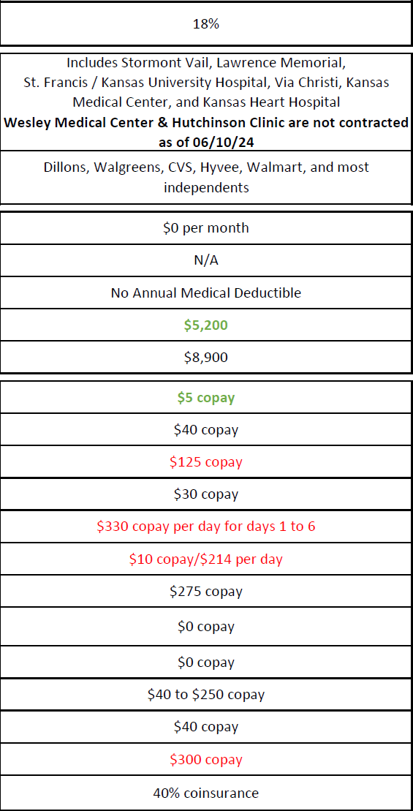
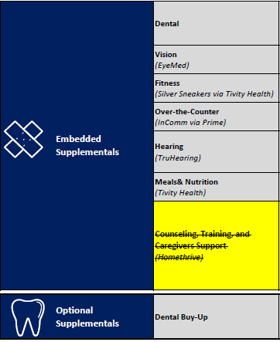
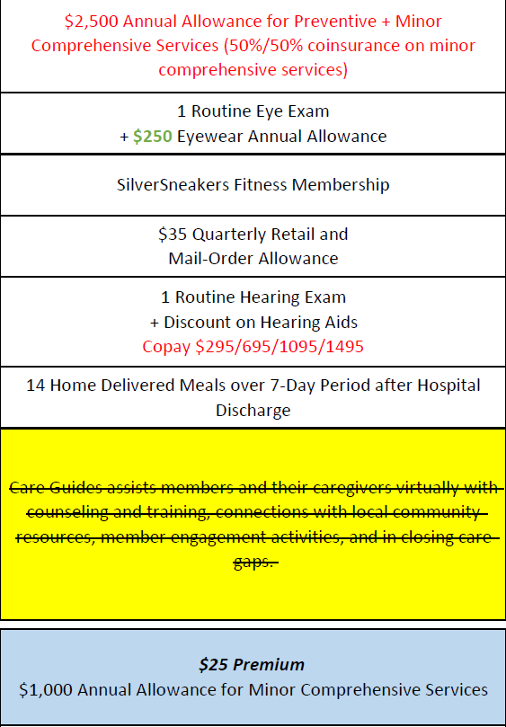
2025 BMA PPO Topeka Region *changes in red and green*

Slide 6
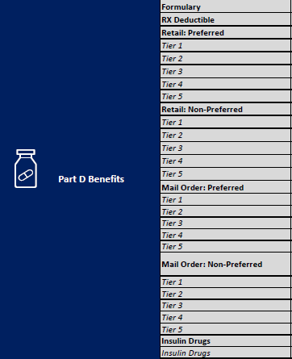
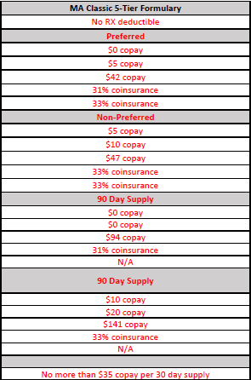
2025 BMA PPO Topeka Region *changes in red*

Slide 7
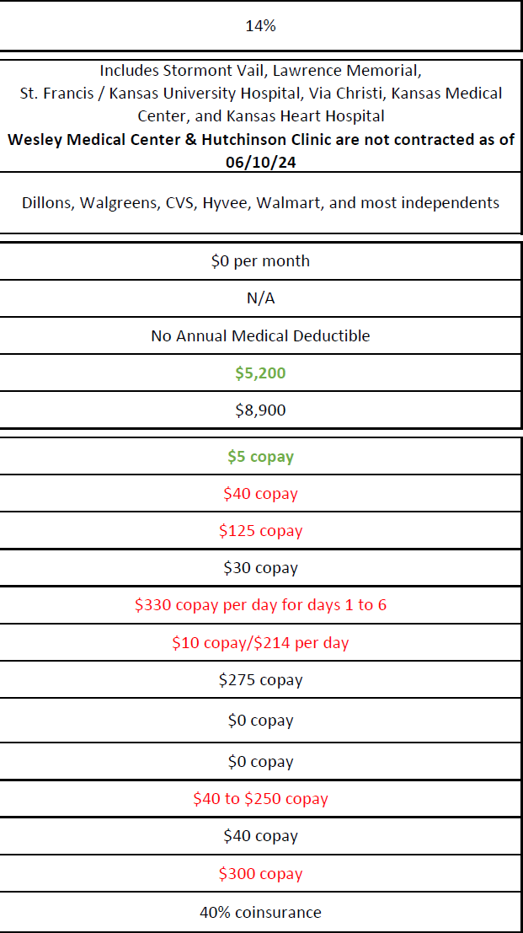
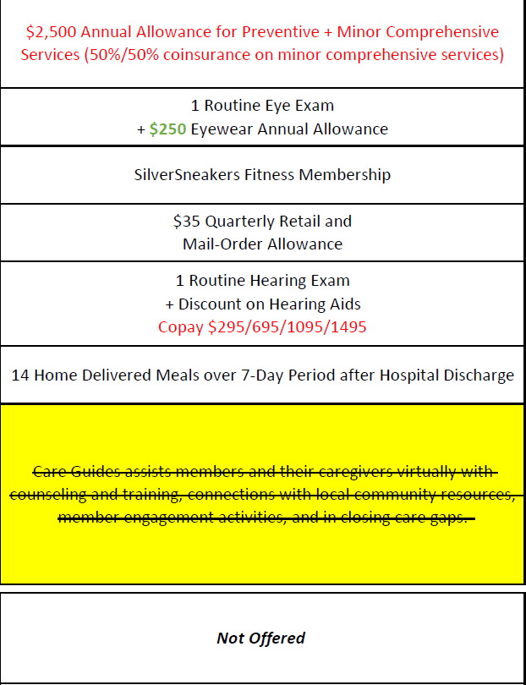
2025 BMA PPO Wichita Region *changes in red and green*

Slide 8
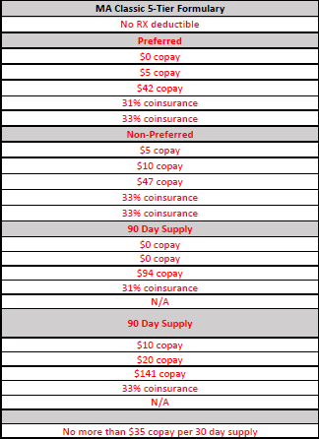
2025 BMA PPO Wichita Region *changes in red*

Slide 9
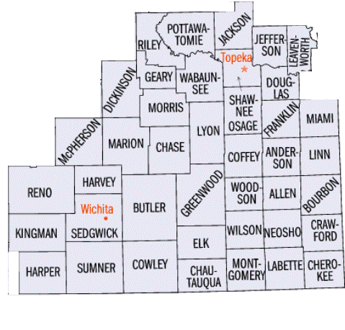
2025 BMA Choice, Freedom and Comprehensive plan Service Area
$0 Blue Medicare Advantage Choice and Blue Medicare Advantage Freedom
$40 Blue Medicare Advantage Comprehensive
41 Counties – 14 New counties added in 2025

Slide 10
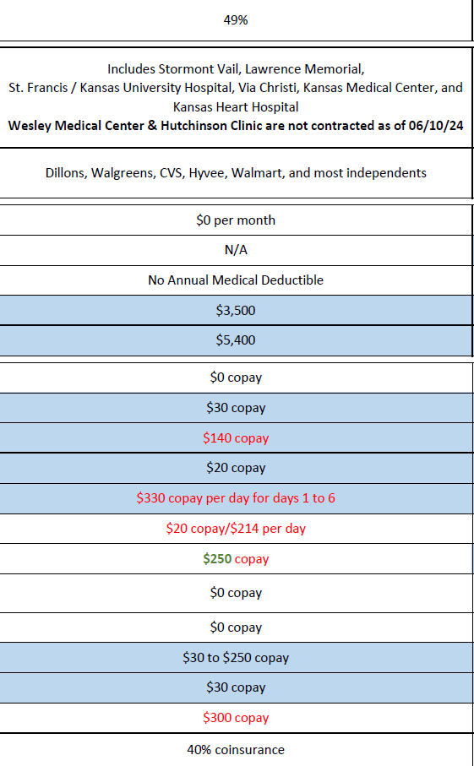
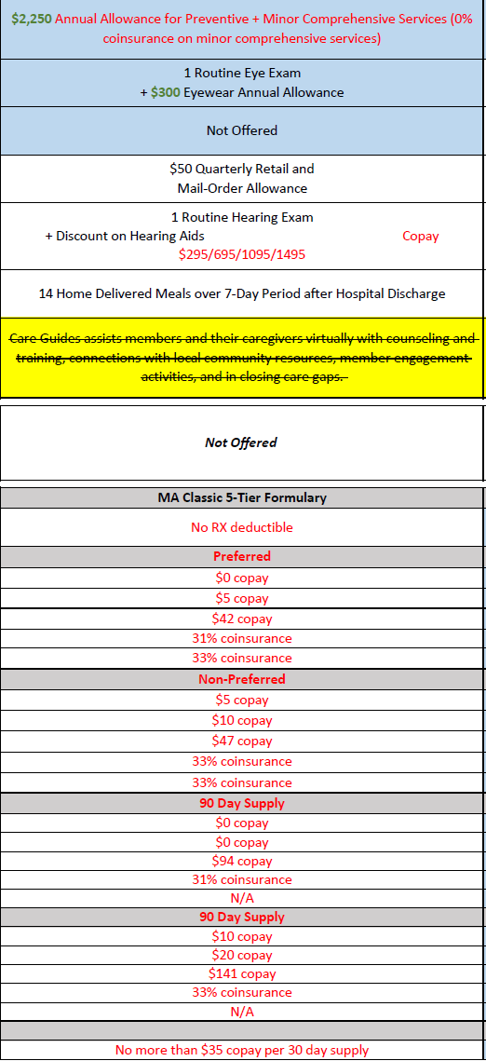
2025 BMA Choice (PPO) Plan Overview *Changes in Red and Green*

Slide 11
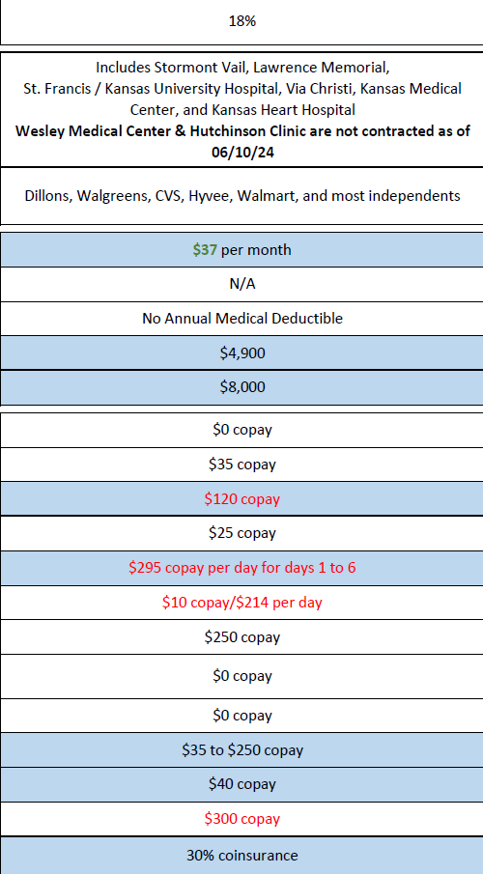
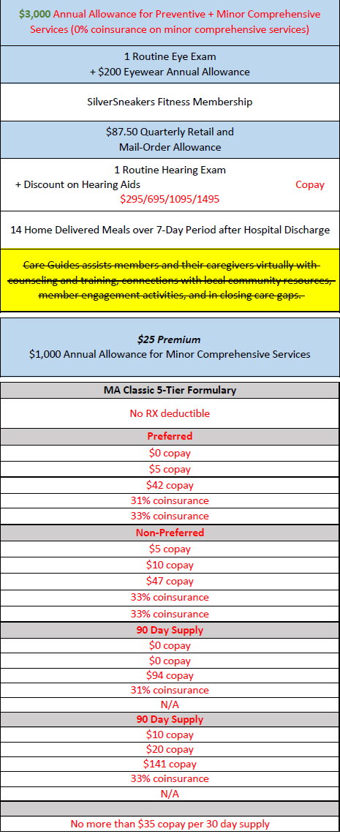
2025 BMA Comprehensive (PPO) Plan Overview *Changes in Red and Green*

Slide 12
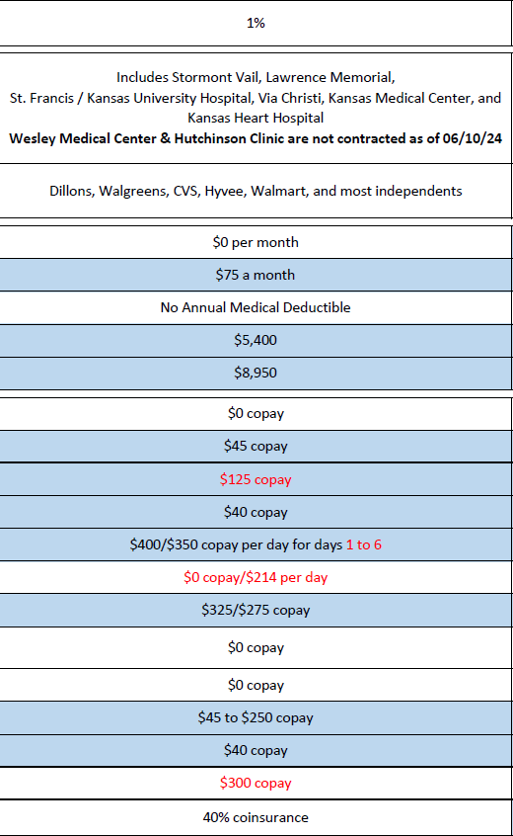
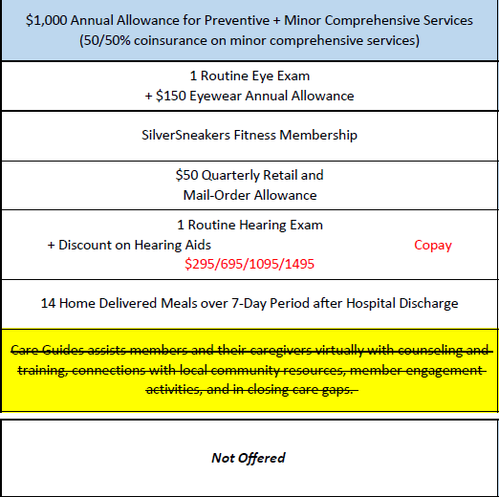
2025 BMA Freedom (PPO) *Changes in Red* *Note – No Part D coverage*

Slide 13
Medicare Advantage: Eligibility and Enrollment

Slide 14
C
Overview of CMS Selling Periods
CMS only allows Medicare beneficiaries to enroll in Medicare Advantage during certain times of the year. Review the eligibility qualifications for each selling period carefully, as adhering to these regulations is critical.
January 1 – March 31
During the OEP, consumers with a MA plan can:
Switch to another MA Plan
Disenroll from a MA Plan and return to Original Medicare
April 1 – October 14
During Pre-AEP, new MA plans can:
Perform Educational Events and communicate Educational content about general Medicare
Announce new MA Provider Partnerships
Call existing BCBSKS members or prospective enrollees who have requested to be contacted
October 15 – December 7
During the AEP, consumers can:
Sign up for Medicare health or prescription drug coverage
Change their Medicare health or prescription drug coverage
JANUARY 1
APRIL 1
OCTOBER 1
DECEMBER 7
Open Enrollment Period (OEP) | Pre-Annual Enrollment Period (Pre-AEP) | Market Open | Annual Enrollment Period (AEP)
Special Enrollment Period (SEP)
We are
currently in
Pre-AEP!
DECEMBER 31
Year-round Examples qualifying a consumer for SEP: The consumer has just become eligible for Medicare (Age-In) The consumer moves out of the current plan’s service area The consumer has or loses Medicaid The consumer qualifies or loses Extra Help The consumer lives in an institution (e.g. nursing home)
During this period, MA plans:
Can begin Marketing MA product benefits
Cannot enroll members until October 15

Slide 15
C
Communications Pre and During AEP
Communications Pre and During AEP
During the Pre-Annual Enrollment Period, all communications must remain strictly educational and simply provide information without influencing potential enrollees decisions. During the Annual Enrollment Period, communications may be used to inform a potential enrollee about plan specifics and benefits as well as attempt to influence the enrollee’s decision-making process when choosing a plan.
JANUARY 1
APRIL 1
OCTOBER 1
DECEMBER 7
OEP | Pre-AEP | Market Open | AEP
SEP
DECEMBER 31
Pre-AEP: Educational Communication
AEP: Marketing Communication
During Pre-AEP, all communications must be used to provide information to current and prospective enrollees. This means that no activities or materials during Pre-AEP may mention specific products and their benefits or have the intent of drawing the attention of a current or prospective enrollee to influence the enrollee’s decision-making process about joining a plan.
During the AEP, activities and the use of materials by the Plan/Part D sponsor may have the intent to draw a beneficiary's attention to a plan or plans and to influence a beneficiary's decision-making process when selecting a plan for enrollment or deciding to stay enrolled in a plan (that is, retention-based marketing). Additionally, marketing materials may contain information about the plan’s benefit structure, cost sharing, measuring, or ranking standards.
Source: Medicare Communications and Marketing Guidelines, 2019

Slide 16
C
Medicare Advantage Eligibility Criteria
Use the criteria in the table below to determine if a candidate is eligible for Medicare Advantage.
In general, an individual is eligible to elect an MA plan when each of the following requirements is met:
As of 2021 individuals that have been determined to have ERSD are eligible to apply for coverage. | The individual or his/her legal representative completes an enrollment request and includes all the information required to process the enrollment or meets alternative conditions for enrollment specified by CMS.
The individual permanently resides in the service area of the MA plan.
The individual is a U.S. citizen or lawfully present in the United States. | The individual is fully informed of and agrees to abide by the rules of the MA organization that were provided during the enrollment request.
The individual is entitled to Medicare Part A and enrolled in Part B, provided that he or she will be entitled to receive services under Medicare Part A and Part B as of the effective date of coverage under the plan. | The individual makes a valid enrollment request that is received by the plan during an election period (see Overview of CMS Selling Periods slide).
Source: MA Enrollment and Disenrollment Guidance, 2019

Slide 17
Marketing Periods
What is the period for marketing of Medicare Advantage
products called? When does this period begin and end?
Answer:
Marketing can begin on October 1, but sales for MA products may not
begin until the Annual Enrollment Period (AEP) on October 15.
The end of AEP is December 7.

Slide 18
CMS Requirements for Sales Call Centers

Slide 19
C
Call Center CMS Regulations
Due to the overarching increase in expected call volumes and narrow Annual Enrollment Period selling window (October 15 – December 7), BCBSKS has contracted with Faneuil to assist with Medicare Advantage telephonic sales.
Category | CMS Regulations
Hours of Operation | October 1 – March 31: 8:00 AM to 8:00 PM CST, 7 days per week Hours: 8:00 AM to 8:00 PM CST, 7 days per week during AEP and OEP (October 1 to March 31) April 1 – September 30: 8:00 AM to 8:00 PM CST, Monday to Friday
Answer Rate | 80% of incoming calls within 30 seconds
Disconnect Rate | 5% or below
Returning Calls | All prospective enrollee voicemails must be returned within 1 business day.
Please Note: Customer Service calls post-sale will be supported by Advantasure,
Prime Therapeutics, and our respective Supplemental Benefit Vendors.

Slide 20
C
Brief Review of CY2020 Lax in Regulations
In 2019, CMS provided MA plans more flexibility in the types of communications they can leverage prior to AEP. The revised marketing guidelines allow for some new and unique best practices while also maintaining strict rules that MA plans must adhere to on an ongoing basis.
Best Practices
Never
Distribute your business card and contact info for beneficiaries to use to initiate contact
Collect Scope of Appointment (SOA) forms
Schedule sales / marketing appointments
Distribute plan-specific materials or enrollment packets
Conduct sales presentations or attempt to enroll prospective members
Pre-AEP
Educational Communication
Submit talking points and presentations to CMS prior to use, including those to be used by agents
Clearly label sign in sheets as optional
Collect Enrollment Forms
Adhere to SOA parameters and documentation
Use contact information for anything other than the purpose for which it was collected
Offer meals
Market in restricted areas of a healthcare setting
AEP
Marketing Communication
Source: Medicare Marketing and Communications Guidelines, 2019
Notes:
Source Medicare Marketing and Communications Guidelines, 2019

Slide 21
C
CMS Required Marketing Materials
The resources listed below provide information on BCBSKS benefits, MA Plan operations, and CMS regulatory guidance.
Reference | Contents | Location
BCBSKS References
Evidence of Coverage (EOC) | A comprehensive explanation of the coverage offered by a MA plan | https://www.bcbsks.com/medicare/ | https://www.bcbsks.com/medicare/ forms
Summary of Benefits (SB) | A list of key benefits offered by a MA plan; a shortened version of Chapter 4 of the Evidence of Coverage |  | https://www.bcbsks.com/medicare/ forms
Provider Directory | A list of all the providers contracted by a MA plan | https://www.bcbsks.com/medicare/ | https://www.bcbsks.com/medicare/ forms
Pharmacy Directory | A list of all the pharmacies contracted by a MA plan | https://www.bcbsks.com/medicare/ | https://www.bcbsks.com/medicare/ forms
Formulary | A list of the drugs covered by a MA plan | https://www.bcbsks.com/medicare/ | https://www.bcbsks.com/medicare/ forms
CMS References
Communications & Marketing Guidelines | CMS regulations for Marketing and Selling Medicare Advantage products | 2019 Medicare Communications & Marketing Guidelines | Medicare Communications & Marketing Guidelines
Medicare Advantage Enrollment & Disenrollment Guidance | Chapter 2 of the Medicare Managed Care Manual details CMS regulations for enrollment and disenrollment of MA Members | 2019 MA Enrollment and Disenrollment Guidance | Enrollment & Disenrollment Guidance
Medicare Managed Care Manual | Managed Care Manual contains all applicable regulatory requirements for operation / administration of Medicare Advantage plans | 2019 Medicare Managed Care Manual | Medicare Managed Care Manual

Slide 22
Medicare Advantage Buyer Behaviors

Slide 23
C
National Senior Market Buyer Behaviors
Medicare beneficiaries have the option to stay in Original Medicare or supplement their coverage with a MA plan or Med Supp policy. MA plans are attractive to seniors due to lower premiums and the inclusion of Part D coverage and supplemental benefits.
Original Medicare
Parts A + B
Medicare Supplement
Parts A + B
Medicare Advantage
Part C
Price
Budget conscious individuals typically do not want to pay the additional premium over and above that paid for Medicare Part B.
Original Medicare beneficiaries must pay their Part A deductible and Part B premiums
Beneficiaries must pay a monthly premium, dependent on the level of supplemental coverage obtained
Typically attracts more affluent consumers that do not mind paying higher premiums (average of $183/month)
Some MA plans cost no more per month than Original Medicare ($0 premium plans)
Some plans may offer lower coinsurance than that charged by Original Medicare (20%)
Cap on out-of-pocket health spending (Original Medicare has no out-of-pocket max)
Network
Broadest possible choice in doctors and medical providers (more doctors accept Medicare than MA)
Maximum flexibility when seeking medical specialties (no prior authorizations to see specialists)
Broadest possible choice in doctors and medical providers (more doctors accept Medicare than MA)
Maximum flexibility when seeking medical specialties (no prior authorizations to see specialists)
Designated HMOs require patients to see a PCP for a referral to visit a specialist
PPO plans allow members to see a specialist without a referral (out-of-network could cost more, however)
Product Design
Original Medicare then covers most services at 20% coinsurance to the beneficiary
Original Medicare has no drug coverage (unless member adds Part D)
Alternative to enhance Original Medicare coverage (e.g. lower copays / coinsurance on Medicare-covered services)
Medicare Supplement has no drug coverage (unless member adds Part D)
Alternative to enhance Original Medicare coverage (e.g. lower copays / coinsurance on Medicare-covered services)
Can include value-added benefits not covered by Original Medicare (e.g. vision, dental, hearing)
MA plans can include Part D prescription drug coverage (MAPD vs. MA)
Source: US Health News, Medicare vs. Medicare Advantage: How to Choose, 2018
Notes:
Source: US Health News, Medicare vs Medicare Advantage: How to Choose, 2018

Slide 24
C
National MA Selection Criteria: Price
Medicare Advantage offers consumers product features that are not covered by traditional Medicare. Additionally, many plans are available at a $0 premium and/or include Part D drug coverage.
Critical Product Features
MA Enrollment by Monthly Premium Price Points:
Price
Over 94% of Medicare beneficiaries have access to a $0 premium Medicare Advantage plan.¹
Blue Medicare Advantage Comprehensive (PPO) has a $40 premium in ALL regions!
Network
While HMO products cover 2/3 of MA members, access to preferred PCP remains a key decision point.^{1,3}
Blue Medicare Advantage (PPO) has a $0 premium in both the Topeka and Wichita regions!
Product Design
Market research suggests that 97% of MA plans provided coverage for a minimum of one extra ancillary benefit — vision, dental, or hearing.¹
41%
$70
of Age-ins selected products on the basis of premium affordability³
is the average premium for products outside of $0 plans, thus creating two distinct pricing markets¹
Sources: 1- Kaiser Family Foundation; 2- Pareto Spotlight Tool, 2018 CMS Enrollment Data; 3- Deft 2018 Medicare Age-In Study
Notes:
Sources: 1-Kaiser Family Foundation; 2- Pareto Spotlight Tool, 2018 CMS Enrollment Data; 3- Deft 2018 Medicare Age-In Study

Slide 25
C
National MA Selection Criteria: Network
Nationally, most Medicare Advantage products are HMO’s with more narrow networks. However, PPO Medicare Advantage products continue to grow in popularity and currently dominate the Kansas Medicare Advantage market.
Critical Product Features
MA Enrollment by Network Type:
Price
21.4
22.3
Over 94% of Medicare beneficiaries have access to a $0 premium Medicare Advantage plan.¹
19.8
17.5
18.4
16.4
14.9
12.7
All BCBSKS Medicare Advantage products are PPOs, thus meeting the increasing market demand!
11.3
Network
While HMO products cover 2/3 of MA members, access to preferred PCP remains a key decision point.^{1,3}
9.0
7.0
Product Design
Market research suggests that 97% of MA plans provided coverage for a minimum of one extra ancillary benefit — vision, dental, or hearing.¹
24.3%
33%
annual growth in PPO product enrollment between 2009-2019
of MA enrollees considered access to their preferred PCP a primary consideration
Sources: 1- Kaiser Family Foundation; 2- Pareto Spotlight Tool, 2018 CMS Enrollment Data; 3- Deft 2018 Medicare Age-In Study
Notes:
Sources: 1-Kaiser Family Foundation; 2- Pareto Spotlight Tool, 2018 CMS Enrollment Data; 3- Deft 2018 Medicare Age-In Study

Slide 26
C
National MA Selection Criteria: Product Design
MA offers consumers product features that are not covered by traditional Medicare. These supplemental benefits can range from Dental and Vision to Meal Delivery, OTC allowances and transportation services.
Critical Product Features
Plans Offering the following Ancillary Benefits¹:
4 of the 5 BCBSKS Medicare Advantage plans offer Dental, Fitness (BMA Choice does not offer the fitness benefit), and Vision!
Price
Over 94% of Medicare beneficiaries have access to a $0 premium Medicare Advantage plan.¹
77%
69%
62%
Network
While HMO products cover 2/3 of MA members, access to preferred PCP remains a key decision point.^{1,3}
Dental Benefit
Fitness Benefit
Vision Benefit
Regulatory hurdles decreased
Supplements are becoming market standard
Product Design
Market research suggests that 97% of MA plans provided coverage for a minimum of one extra Ancillary benefit — vision, dental, or hearing.¹
Supplemental benefits are defined as extra benefits not covered under traditional Medicare. CMS continues to relax rules around the definition of supplemental including Over the Counter (OTC), Transportation, and Meal Delivery.
Most MA plans embed Dental, Fitness or Vision within their product benefits
Since 2010, the share of enrollees in plans that provide fitness or dental care has increased (from 52% and 48% of enrollees, respectively).
Sources: 1- Kaiser Family Foundation; 2- Pareto Spotlight Tool, 2018 CMS Enrollment Data; 3- Deft 2018 Medicare Age-In Study
Notes:
Sources: 1-Kaiser Family Foundation; 2- Pareto Spotlight Tool, 2018 CMS Enrollment Data; 3- Deft 2018 Medicare Age-In Study

Slide 27
Blue Cross Blue Shield of Kansas: Medicare Advantage Product Overview

Slide 28
C
Types of Medicare Plans
There are a number of Medicare Advantage plan options available to consumers. BCBSKS has a Preferred Provider Organization (PPO) product.
 | Original Medicare | Health Maintenance Organization (HMO) | Preferred Provider Organization (PPO) | Special Needs Plan (SNP) | Private Fee-For-Service (PFFS)
Can I get a my health care from any doctor, other health care provider, or provider? | Yes, if they accept Medicare | No. Enrollee must get their care and services from doctors, other health care providers, or hospitals in the plan’s network. | In most cases, yes. PPO plans have network doctors, other health care providers, and hospitals, but enrollees can also use out-of-network providers for covered services, usually for a higher cost. | Enrollees generally must get their care and services from doctors, other health care providers, or hospitals in the plan’s network (except emergency care, out-of-area urgent care, or out-of-area dialysis). | Enrollees can go to any Medicare-approved doctor, other health care provider, or hospital that accepts the plan’s payment terms and agrees to treat you. If enrollees join a PFFS plan that has a network, enrollees can see any of the network providers who have agreed to always treat plan members
Are prescription drugs covered? | No | In most cases, yes. If you want Medicare drug coverage, you must join a HMO plan that offers a prescription drug coverage. | In most cases, yes. If you want Medicare drug coverage, you must join a PPO plan that offers a prescription drug coverage. | Yes. | Sometimes. If enrollees PFFS plan does not offer drug coverage, enrollee can join a Medicare Prescription Drug Plan to get coverage.
Is there a limit to my out-of-pocket spending? | No | Yes, all Medicare Advantage plans must have limits on out-of-pocket spending | Yes, all Medicare Advantage plans must have limits on out-of-pocket spending | Yes, all Medicare Advantage plans must have limits on out-of-pocket spending | Yes, all Medicare Advantage plans must have limits on out-of-pocket spending
Do I have to get a referral to see a specialist? | No | In most cases, yes. Certain services, like yearly screening mammograms, do not require a referral. | In most cases, no. | In most cases, yes. Certain services, like yearly screening mammograms, do not require a referral. | No
Source: CMS Managed Care Manual, 2019
Notes:
Source: CMS Managed Care Manual, 2019

Slide 29
C
Blue Medicare Advantage: Value-Added Benefits
Medicare Advantage plans can embed supplemental benefits that provide additional coverage above what Original Medicare covers. Supplemental benefits are allowed as long as they are “health-related;” therefore, there are quite a few variations in the national MA market.
Common Medicare Advantage Supplemental Benefits
Acupuncture | In-Home Safety Assessment | Readmission Prevention
Alternative Therapies | Meals Benefit | Remote Access Technologies
Bathroom Safety Devices | Medical Nutrition Therapy (MNT) | Repairs
Routine Chiropractic Services | Nutritional / Dietary Benefit | Telemonitoring Services
Counseling Services | Over-the-Counter (OTC) Benefit | Transportation Services
Dental Services | Personal Emergency Response System (PERS) | Vision Services
Fitness Benefit | Physical Exam | Visitor / Travel Benefit
Enhanced Disease Management (EDM) | Point of Service (POS) | Weight Management Programs
Health Education | Post-discharge in-home Medication Reconciliation | Wigs for Hair Loss Related to Chemotherapy
Hearing Services | Preventive Benefits | Worldwide Emergency / Urgent Coverage
BCBSKS Benefit Covered | OON Services Available? | Vendor
Dental Services | Yes
Fitness Benefit | No
Hearing Services | Exam – Yes Aids - No
Meals Benefit | No
Over-the-Counter (OTC) Benefit | No
Vision Services | Yes
Telehealth | Yes | Covered by BCBSKS Network
Other Services | Yes | Covered by BCBSKS Network or BlueCard

Slide 30
Product Specifics
Who are the key in-network medical systems present in
BCBSKS Kansas’s Topeka and Wichita regions?
Answer:
Topeka: Stormont Vail, Lawrence Memorial, and St. Francis / KU Hospital
Wichita: Via Christi, Kansas Medical Center, and Kansas Heart Hospital

Slide 31
Blue Cross Blue Shield of Kansas Supplemental Benefits Deep Dive

Slide 32
Vision 101

Slide 33
Common Vision Terms
Common vision terms
Network: a group of providers that a plan has contracted with to offer services to its members. These providers are considered in-network and may be independent or part of a national or regional retail chain.
Here is a look at your network,
Allowances: the dollar amount a member has to spend on frames and contacts before incurring any out-of-pocket costs. Allowances typically range from $100-$200 .
Here is a look at your plan allowances,
Network name | Providers | Locations
Insight | 103,400 | 26,000
Package allowance(s)
Depends on plan- See plan details

Slide 34
Common vision terms
Copay: a small dollar amount the member pays with the rest of the cost covered by the insurer. Copays range from $0-$45.
Your plans offer,
Frequency: the time period a member can use their benefit for different services and material benefits (exam/lens/frame).
Your plans have the following frequencies,
Benefit | Copay
Eye Exam | $0 copay
Plan Frequency
12 months / 12 months

Slide 35
VISION DISCOUNTS
Standard vision plan discounts:
20% off balance over frame allowance
15% off balance over conventional contact
15% off retail or 5% off promotional price LASIK
40% off additional pairs of prescription glasses
20% off a pair of non-prescription glasses

Slide 36
Top 3
If you remember anything today, remember this;
1
Vision care is important because its impact reaches over 190 million U.S. adults and affects all age groups from babies to seniors
2
The components of a vision plan are: exam, materials (frames, lenses, lens options, contact lenses) , and discounts
3
On average, a vision plan will save a member 71% compared to paying retail

Slide 37
BCBS KS Sales and Agent Training
September 2024

Slide 38
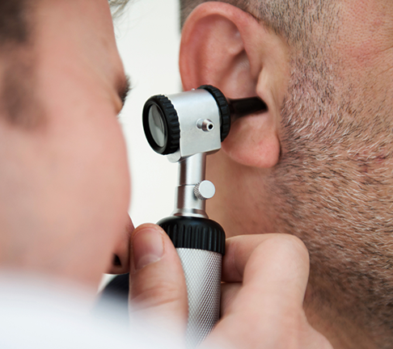
The Member Experience
Member Calls TruHearing at
1-833-734-4426
Member Visits a Provider for a Hearing Exam
Member is Fitted and Trained on Hearing Aids

Slide 39
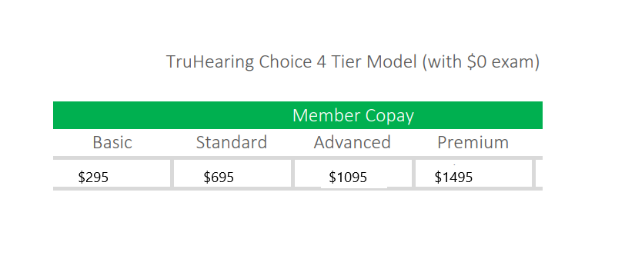

Slide 42
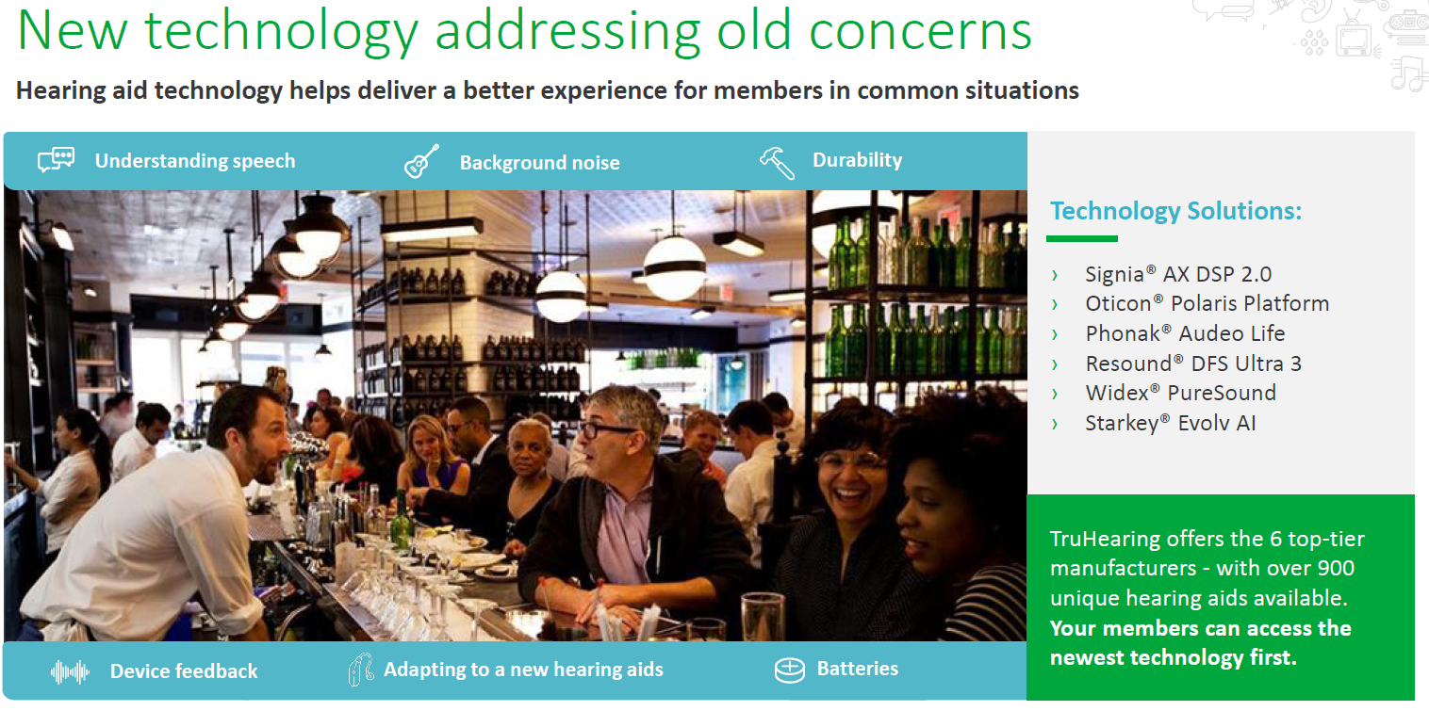

Slide 44
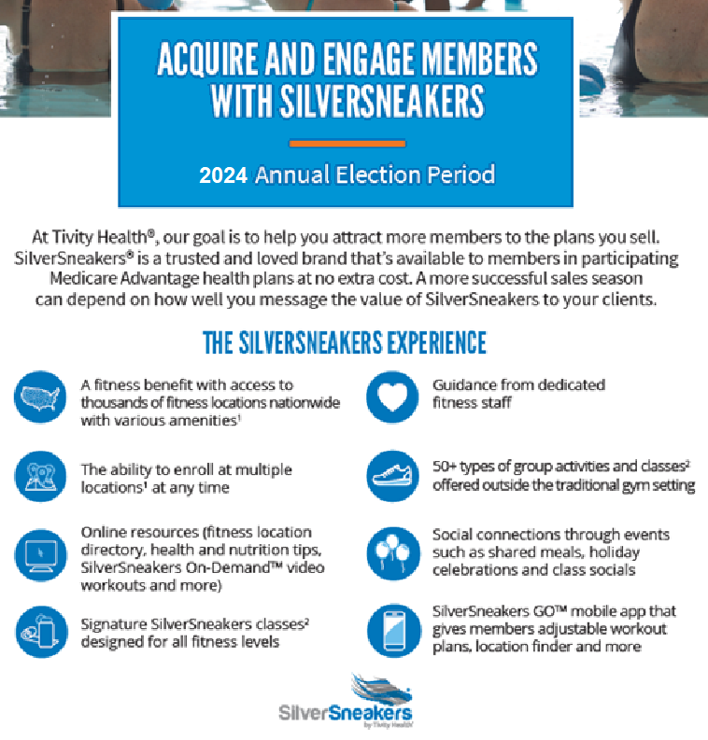
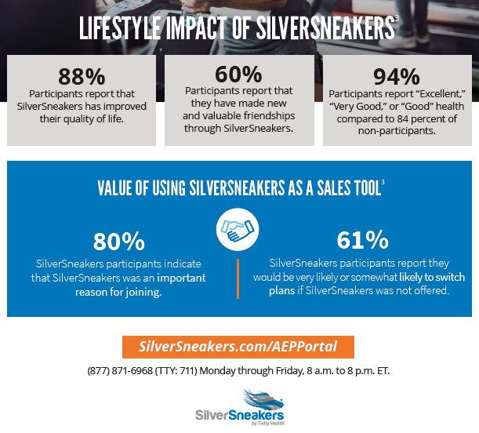
SilverSneakers

Slide 45
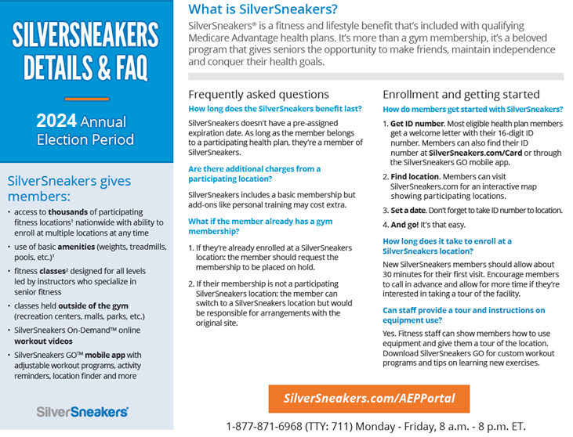

Slide 46
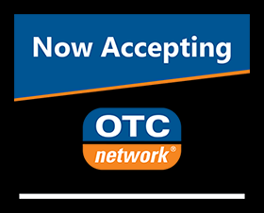

Slide 47
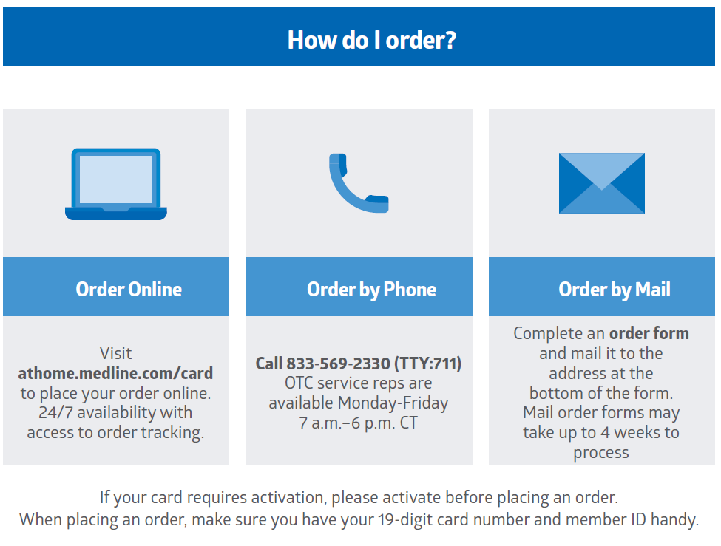
InComm Over-The-Counter Benefits

Slide 48
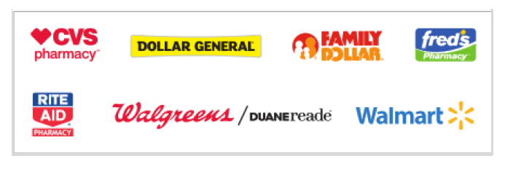
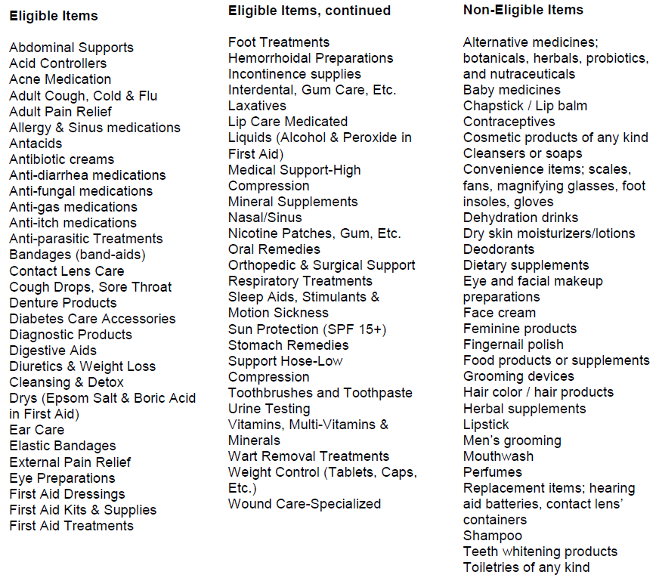
InComm Over-The-Counter Benefits
USING THE CARD AT PARTICPATING RETIAILERS
COVERED OTC ITEMS
Above list of participating retailers subject to change at any time.
For details on approved items, check the website at myotccard.com and/or download the OTC Network mobile app to scan items at retail locations.
List of example covered items provided right.

Slide 49
Product Specifics
What are the premiums of each of BCBS Kansas’s
Medicare Advantage offerings?
Answer:
Both Blue Medicare Advantage (PPO) plans and
the Blue Medicare Advantage Choice have $0 premiums.
Blue Medicare Advantage Comprehensive (PPO) plan has a
$40 premium. Blue Medicare Advantage Freedom (PPO) has a $0 premium.

Slide 50
Product Specifics
What are the standard out-of-network coinsurance amounts
for each BCBSKS Medicare Advantage product?
Answer:
Blue Medicare Advantage Plans: 40%
Blue Medicare Advantage Choice 40%
Blue Medicare Advantage Freedom 40%
Blue Medicare Advantage Comprehensive Plans: 30%

Slide 51
Blue Cross Blue Shield of Kansas: Medicare Advantage Pharmacy Benefits

Slide 52
D
Blue Medicare Advantage: High-Level Offering
Each BCBSKS product contains different Part C copays and coinsurance to meet Topeka and Wichita market norms for pricing.
 | Topeka Blue Medicare Advantage (PPO) | Wichita Blue Medicare Advantage (PPO) | All Regions Blue Medicare Comprehensive (PPO) | All Regions Blue Medicare Advantage Choice (PPO)
Network | No Preferred Retail Pharmacies. Standard Retail Pharmacies include other independent pharmacies throughout Kansas support network adequacy. A Mail-Order Pharmacy is also available via Prime Therapeutics.
Phase 1: Deductible | All plans do not have a pharmacy deductible.
Phase 2: Initial Coverage | See next slide.
Phase 3: Coverage Gap | New for 2025 the Coverage Gap and Catastrophic coverage have been eliminated. MOOP for Part D Plans is $2000/yearly
Phase 4: Catastrophic | After your yearly out-of-pocket drug costs reach $2,000 , you nothing for covered Part D drugs.
**See the changes in red**

Slide 53
D
Blue Medicare Advantage: Part D Initial Coverage
During the Initial Coverage phase, the beneficiary is responsible for paying a co-pay or coinsurance for their covered drugs, until the Initial Coverage Limit (ICL) of $2,000 is reached.
 | Description | Topeka Blue Medicare Advantage (PPO) | Wichita Blue Medicare Advantage (PPO) | All Regions Blue Medicare Advantage Freedom(PPO) | All Regions Blue Medicare Advantage Comprehensive (PPO) | All Regions Blue Medicare Advantage Choice (PPO)
Tier 1: Preferred Generic | The least expensive drugs your plan covers in order to offer a choice of low cost medications. | $0 copay | $0 copay | N/A | $0 copay | $0 copay
Tier 2: Generic | Certain drugs covered to offer a larger choice of generic medications. The member’s cost is higher for generic drugs than preferred generics. | $5 copay | $5 copay | N/A | $5 copay | $5 copay
Tier 3: Preferred Brand | A drug that is invented by a manufacturer and is sold under their brand name. | $42 copay | $42 copay | N/A | $42 copay | $42 copay
Tier 4: Brand | Drugs considered non-preferred (brand names or generics that are not the “most effective”) | 31% coinsurance | 31% coinsurance | N/A | 31% coinsurance | 31% coinsurance
Tier 5: Specialty Tier | The most expensive drugs due to their designation as rare and costly to produce | 33% coinsurance | 33% coinsurance | N/A | 33% coinsurance | 33% coinsurance
Note: The above cost-shares represent preferred retail and preferred mail-order cost-shares for a 30-day supply. Cost-shares may vary depending on the pharmacy members choose or the Rx day supply. For more information, access the Evidence of Coverage.

Slide 54
Closing Remarks

Slide 55
Appendix

Slide 56
C
Regulatory Guidelines
This table defines the communication guidelines and requirements and their applicability to BCBSKS MA Plans.
Requirement | Definition | Applicability to BCBSKS
Anti-Discrimination | Plans may not discriminate based on race, ethnicity, religion, sex, etc. | BCBSKS must follow Anti-Discrimination rules
Plan Name & Type | Plans must include the plan type when referring to plan name | Blue Medicare Advantage (PPO) Blue Medicare Advantage Comprehensive (PPO)
Non-English Speaking Population | Interpreters must be available for any language that is the primary language for >5% of the plan’s service area | There must be a Spanish interpreter since Spanish is the primary language of >5% of our 14-county service area
Hours of Operation (Sales) | Not subject to same CMS scrutiny as Customer Service Hours of Operation, however, market norm is to match Customer Service hours of operation. | (BCBSKS): 8am-4:30pm Monday-Friday (Faneuil): 8am-8pm CST, 7 days/week, 10/1-3/31; 8am-8pm CSST, Monday- Friday, 4/1-9/30
Hours of Operation (Customer Service) | Hours of Operation must be included on all marketing materials with a phone number | (Advantasure): 8am-8pm CST, 7 days/week, 10/1-3/31; 8am-8pm CSST, Monday- Friday, 4/1-9/30
Use of TTY Numbers | TTY Numbers must be provided with the Customer Service Number | TTY: 711
Electronic Communication | Plans may contact prospective enrollees via email but not via text message | Not expecting to use text message to contact beneficiaries
Prohibited Statements | Plans are prohibited from communicating inaccurate or misleading information | Cannot use “Free” to describe $0 Premium, but can use “Free” to describe supplemental benefits (vision, hearing, SilverSneakers)
Product Endorsements | Product endorsements must be straightforward and not misleading | No endorsements at the moment; Using BCBSA marketing materials
Co-Branding | Co-Branding relationships must be entered into HPMS | BCBSKS is co-branding with Prime
Co-Branding with Providers | Plans may include name/logo of co-branding entities | Currently not applicable
Source: Medicare Marketing and Communications Guidelines, 2019

